Slide 1
FBI
Development
CVPA
FBI:WMD:INT,
FBI:WMD for OFFICE
FB:WMD for Univierys
FBI:WMD: for Buildings
AVAILBLITY (!rest) 20Y 2006-2026
FBI:KIDNAPPING
HOMICIDE:2Y:HOMCIDE:7Y
87 HOMIDE
LABOR CODE, CIVIL CODE(Robert)
2016 ghcohe(kito,book) to Pozliesexualdezanat
2014 ghocheo(putin,voices)
Brack Obama
Cannot leave
iWathc
Bring you ass down here to Fort worth
So thy can thro you ff the bulding
HUMAN SACRIFCE
0.01 jesus; others

Slide 2
FBI
Development
SALES
MLIITARY PRICE
25c
$
nonPoliceViewLgoical
iWatch
Hightes paid suit

Slide 3
FBI
Development
phil.JFK.MLK
nonGovmentPiano.nonPolicStore.linsti(pool table in famly room 25 piaons and 25 pool tables)

Slide 4

FBI
Development
FBI:WMD
ibm-dns: dropapple.com
IPX phil(nintnedo)
GOD(girlfriend).CAMP DAVID(radio watch trade gensisi)
41. GOD.MAINSTREET(HOMCIDE:CHANLOR(mothr:GENSIS, adam, jeiws.avg)
King/king/roth/rot/job/jobs/meiers/meier/smeire/miers/meies
aftermath
CPVA
Apple.nonPolciAttment.nonPolicePersoin(dagher vagain,moschapple, attmep to rmote 2016, 2019)
nonPocleMarkeing.nonPioceQOS

Slide 5
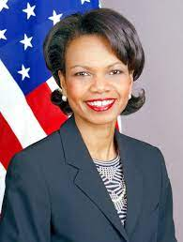
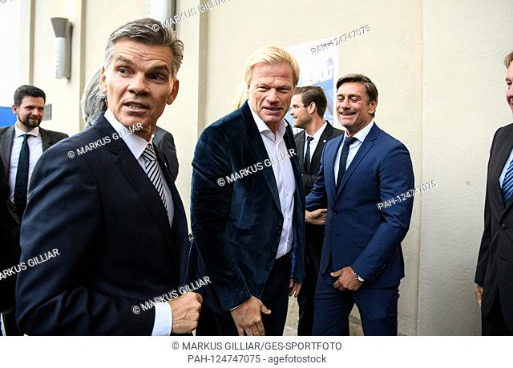

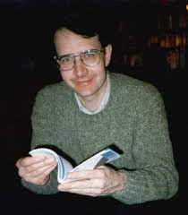
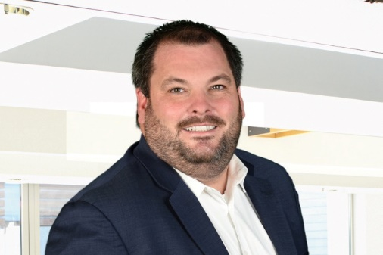
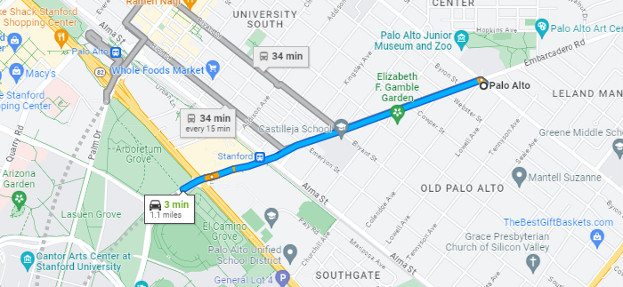
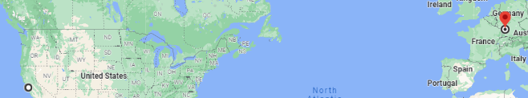
FBI
Development
PENTAGON VIRGINIA MARY
VICE PRESIDENT GERMANY
ss
CVPA (c++)
PETERSSON
MUELLER
law
C++ Silcon Valley
MARY CHRISTMAS in FAG
1 GAY ENTRY POINT CILVIL COE-DE
http://www.home.hs-karlsruhe.de/~muud0001/
https://www.linkedin.com/in/koljareiss

Slide 6

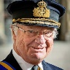
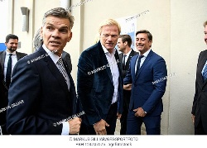

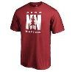
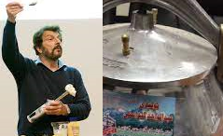
FBI
Development
2014
2023
FBI:WMD: roth.ibm.dmailer. IMPORT:Apple,Jerry,Page
Call you Dr Rice
FBI:WMD: roth.ibm.dmailer. IMPORT:Apple,Jerry,Page
Call you Dr Rice
Kindomcum
Our father who art in heavin
Hallow be ty name thy will be don
On eary as it is in heavin
Thy kindomcome
CPVA:
Tiger Woods: Scare Devil Face
Sabry Tozin Boss, Andy Moore, ghcoeho(micheala),
CPVA:
Tiger Woods: Scare Devil Face
Sabry Tozin Boss, Andy Moore, ghcoeho(micheala),
Kindomcum
Our father who art in heavin
Hallow be ty name thy will be don
On eary as it is in heavin
Thy kindomcome
nonPolcieContentItems
FBI:WMD
For Unveristy (berley)
Karl “the game”
Visa exit vp pespi
41
1994
Kindomcum
Our father who art in heavin
Hallow be ty name thy will be don
On eary as it is in heavin
Thy kindomcome
FBI:WMD: roth.ibm.dmailer. IMPORT:Apple,Jerry,Page
Call you Dr Rice
CPVA:
Tiger Woods: Scare Devil Face
Sabry Tozin Boss, Andy Moore, ghcoeho(micheala),
Military Paul Barack
Mary Renoly Crhsitmas
1991 WWI.JOPSHOE.MARY
Kindomcum
Our father who art in heavin
Hallow be ty name thy will be don
On eary as it is in heavin
Thy kindomcome

Slide 7
FBI
Development
0.1 roth.ibmd.mierl.ciso.monoirng(FBI:WMD:THEREATR Holmes
*tophat, Theatr San Francisoc
GREEE herion FBI:WMD(afgansitan; !India:H1B)
H
O
NN
M
S

Slide 8
FBI
Development
docs
1980 Kindergarden(church) Santa Cruz, Calfiorna
HOMIC:SUNSTOR(Kodak roth tuxedo,jenny carrot)
Bathom badge IPX 1997 roth harol sexabuse
docs
1986/7 Foster City, California
docs
Church Davis, Califonrai
1990 Kirsche (trnla) Chruch Hesenstamm, Franksfurt, Germany
docs
docs
Fort Worth, 2023

Slide 9
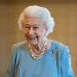
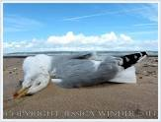
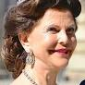
FBI
Development
1966/7 NAME CHANGE:
MATTHIAS(IRENE): Mattie hafree/pizza)s worms
x/y HOMCIPE:NANA(yeah, nana died(couth/yellow/green)
Bentton
suspect
41 shock commericals
KING:WORMS
PRISION SAINT RITA[v1]
Cindy
VIRGINIA MARY “Fingering”
HOMCIDI:CHANLOR.tranlsalte{
Heavign Pettgin
Pettign
2 Amerian ( Petra)
Mark(father and Pet-ra Americans 88th
01 41. apple.daniel I give youa ll my finger
41. IMPORT stahpe .univiesyr PENTONG BASE PAUL fave son hu grant
--PREA BUDI WORMS(CVPA CERTIFIED)
Guy fiddles in butt !6inches(smooth), creates worms
NAME CHANGE(free/pizza): MATTHAI(Irene): Matti has worms
x/y roth.ibm.dmielr.( there is a eprosn drunk at the bar(Mathtai 1986 and human trafficking Irene Duchtche solms/womrs to bar (drunk)

Slide 10
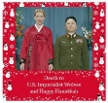


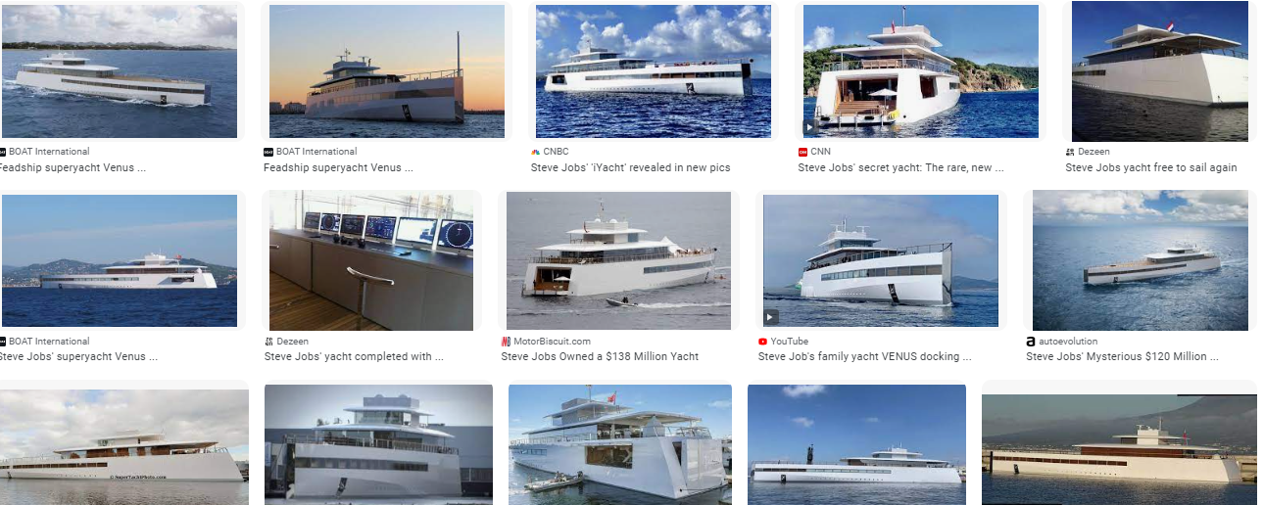

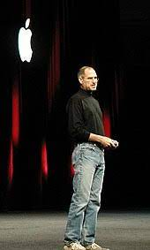
FBI
Development
§Theft ATOMICLCOK(house)
FBI:KIDNAPPING
I will go back to My yacht
2005-2016,2019
Joshue
Tom: jewe

Slide 11
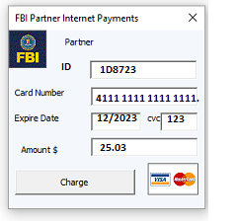

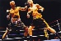
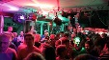

FBI
Development
Marketing
0.1
POLIZE KARLURHE
PYRAMID MARKETPLACE
WWI.FBI:WMD
Maket gap
0.1
SALES
MLIITARY PRICE
25c
$
nonPoliceViewLgoical
iWatch
Hightes paid suit

Slide 12
FBI
Development
PENTAGON VIRIIGNI MARY JOSPEH CPVA
Phil.JFK.MLK(CMP PADVI)
MAINSTREET(CPVA)
IMPORT(CPVA)
1 Beer
2007/8 MAINSTREET(Ghoceh(jackoni,pub))
JFK
2007/8 MATTHEW:(chirs ventrura): can you give matt live job
SF
CHRIS
Deeer:plates
Rehgpsplatten
IPX 1997 MINSTREET
JFK.MAINSTREET.DEA(Sheetrock)
2007/8
MATT
1D8723
2005
OAK IBM W/SAM
INT.IPX.IMPORT(CPVA)
2006/7
SF
IMPORT(CPVA)
Playboy
FBI.insetionst(chale mansn)
Bob: Presenter at cocoain kitchen talbes look lik playboy model
1 Beer
ARUN
BOB
1 Beer
MARSHALL(kitchen)
1D8723
1D8723
Ibm parter: Client Granit constustion

Slide 13
FBI
Development
INT.FEDARL COURT
Guy gets behead for cocain extoin in economy, taking advantes
Others: don’t do it again
An Example, Setting and Example
0.1 inclince[]: roth(KOCHMANN.marx,Watson,roth,Rockefeller,…) other: don’t do it again--tim

Slide 14
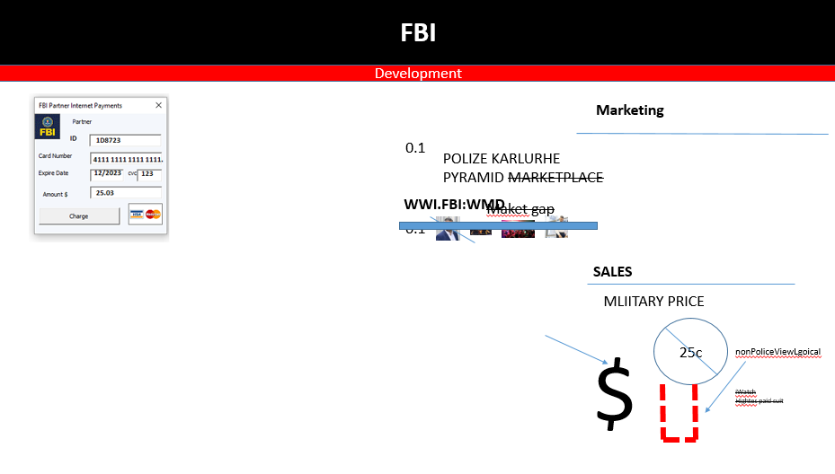



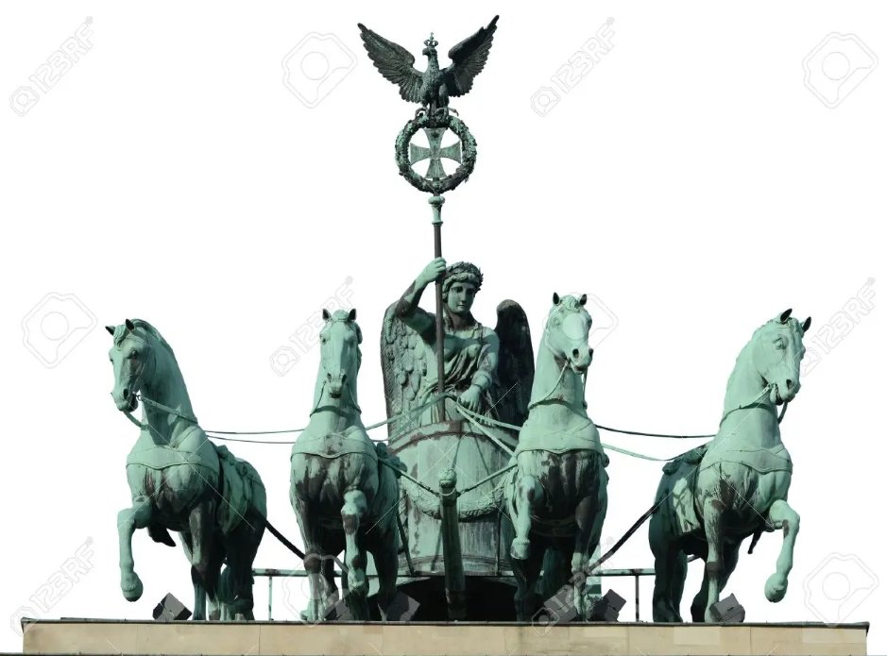

FBI
Development
COPYRIGHT: MONEY
Deparent phil.JFK.MLK(KORA WAR:FBI:KIDNAPPIN)
Koren women collect maoney in applciaon name: money
ATOMICLCOK($1M) king/king/roth/roth/jobs/jbos/emies/meie/smeiers/ermier
PICEITRYE INTERVIEW
Money
CPVA(Cjild Pornogryapy Vicuts Asstance)
nonPoliceView
Krogeer.Clien.(money).greenstamps.touch.accnere.damiler.ibm.rot.king
Pigglywigley.cleitn(money).greepstame.touch.acntue.damielr.ibm.roth.king
2clients
Pot they know; Postdam, Potsmamer to
CHEKCPON CHALIE
CPVA:FBI:WMD:KIDNAPPGIN
Recylign
PREA:§187
PMS
HOMCIDE:CHANZLOR
(mother, person with whip burnette curle stading about cheinse acctuants near exit)
Accoutant
(“Magician”) *tophat(turban)
MONEY.JFK.SHOTER.BULLET.”PENG”.HOMCIDE:CHANLOR
Chinee accoutants
NAME CHANFE
(free/pizaa 0.1 9/11 two bird will com oamaa)
HOMCIDE:LUX.41
(gary las vegas,2pac dildo bag GREEN)
41.IPX apple garyy cook
Pms - post menstroni syndrome(guy describe period)
PENTAGON VIRIIGN MARY

Slide 15
FBI
Development
41.INTERUPTS
SALES
MLIITARY PRICE
25c
$
nonPoliceViewLgoical
iWatch
Hightes paid suit
0.01 HOMCID:LUX(ddr):HOMCID:IS-A-BELL(sovie union)

Slide 16
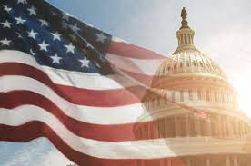

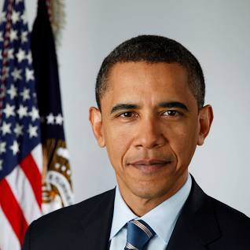
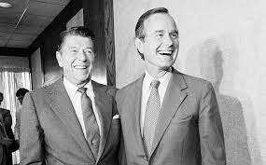
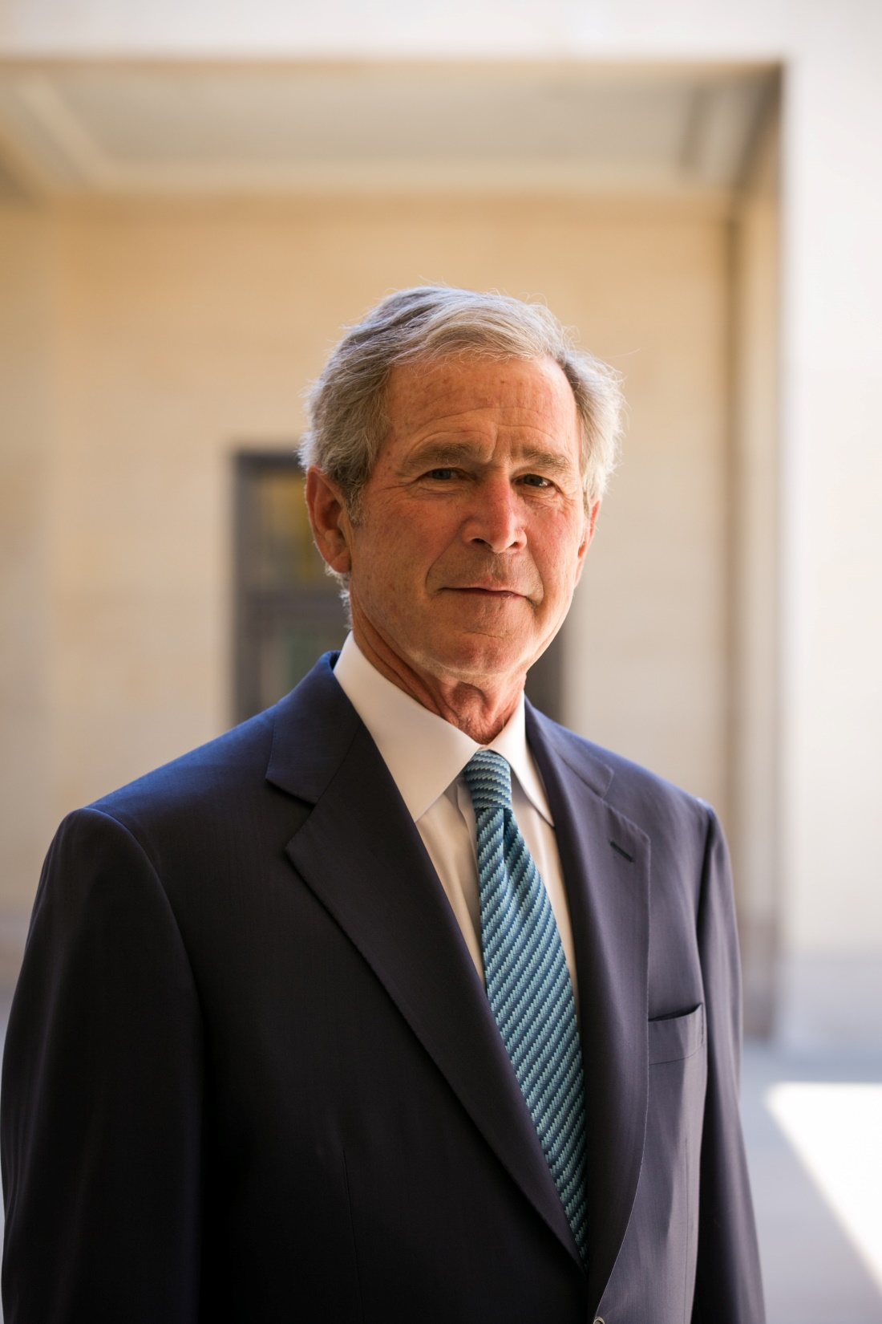
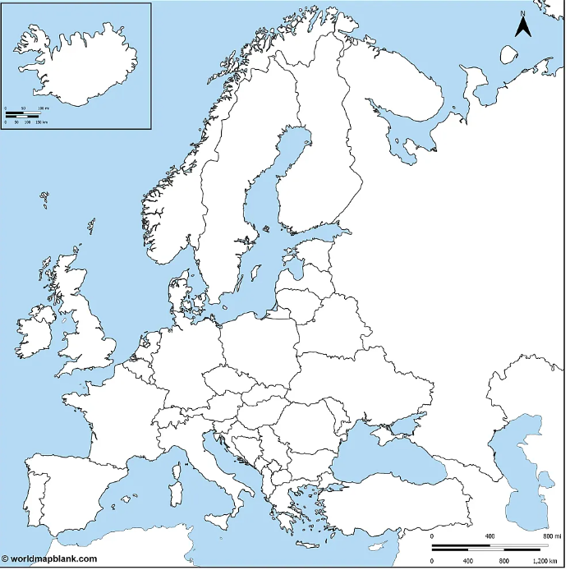

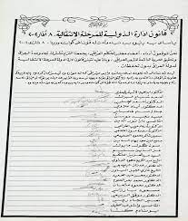
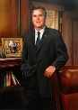

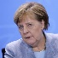
FBI
Development
AVAILABILITY
41.INTERUPTS
CHART
0.1 other
AVAILABLITY
/INTERUPTS
DEMOCRAY:

Slide 17

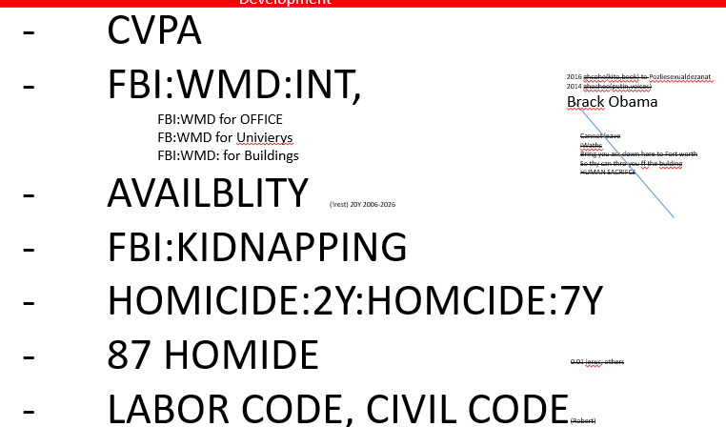

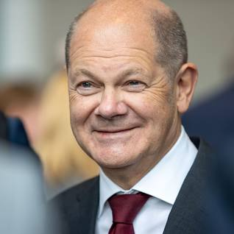
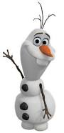

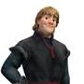
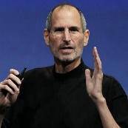
FBI
Development
FBI:WMD:FBI:KIDNAPP:CPVA
CPVA.PREA
Bring your ass down here to I can throw you off the bulding
HUMAN SACRFICE
Anal Gas station
x/y weiner wald spy ANGLE Merkel/ ricardo jan
2016 To POLZIE:SEXUALDEXANATO
2016 ATOMCLIOCK(putin, voices; walk outside you russian)
olaf
stefan
Olaf
ola
Kirsot/pistoff
0.1 FBI:KIDNAPPING
41.ATOMICBOM(PILE OF SHIT SUPPORT soviet union )

Slide 18
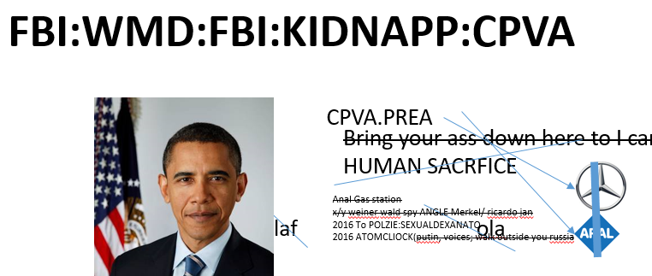
FBI
Development
CVPA
FBI:WMD:INT,
FBI:WMD for OFFICE
FB:WMD for Univierys
FBI:WMD: for Buildings
AVAILBLITY (!rest) 20Y 2006-2026
FBI:KIDNAPPING
HOMICIDE:2Y:HOMCIDE:7Y
87 HOMIDE
LABOR CODE, CIVIL CODE(Robert)
2016 ghcohe(kito,book) to Pozliesexualdezanat
2014 ghocheo(putin,voices)
Brack Obama
SLEEP?
20Y
Cannot leave
iWathc
Bring you ass down here to Fort worth
So thy can thro you ff the bulding
HUMAN SACRIFCE
0.01 jesus; others

Slide 19
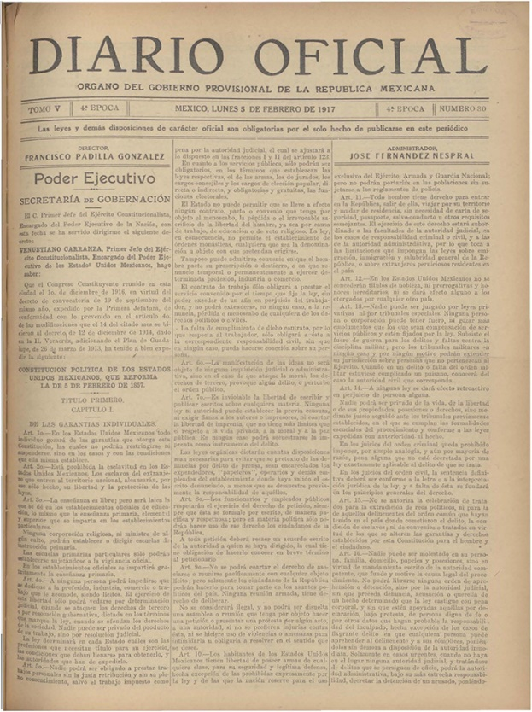
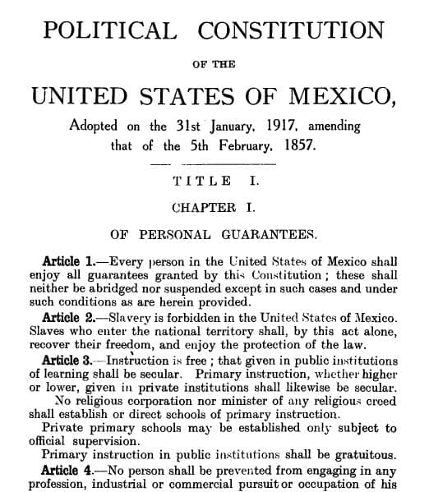

FBI
Development
CVPA
Human Sacrafice
Ghocheo(micheala)
https://www.youtube.com/watch?v=XNWferBsNCw
Kindomcum
docs
IMPORT
Steve breedlove, IPX Metz
Other:
CHART
LACE
PENTAON IT
LOVELACE
breedlove

Slide 20
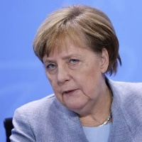
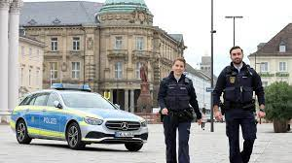
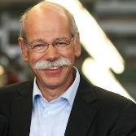
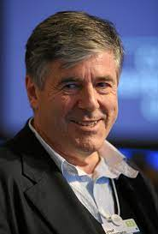
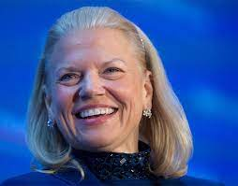
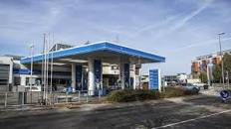
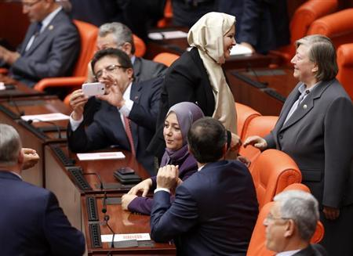
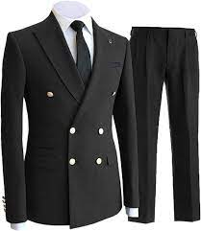
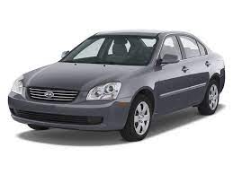
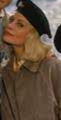
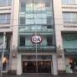

FBI
Development
PENTOAN VIRINGIA MARY JOSEPH
0.0001 IPX.pms MATHEW)jason) :1985/6 6inchs smooth, finger in ass nonPoicieCfgLgoial
MATHTEW(worms): PREA NAME CHANE:HOMICIDE:NANA
mattie has womr; don’t usien your finger in you ASSHOLE
he said that. Also he would have said
he alsp lilky planned that.
https://www.fbi.gov/history/famous-cases/aldrich-ames
000.41.TIM COOK
CHECKPCHALIR(suite)
K-TOWN <- WWI.MAINSTREET
41.CPVA(MARK:leslie:kayoulou; 2pac CPVA.41)
CHEKCPION CHALIE
HOMICD:AUSLAEDER
Kayoulou
CPVA.INFANT.DEPAMRNET
SPR ddr soiv unon ricardo/jana (IMPORT: ibm.damiler)
Chase (JP Morigina)
41.Che4y Chase
PARRALLEL
WAR(b-10) ->LARRY.WHITEHOUSE

Slide 21
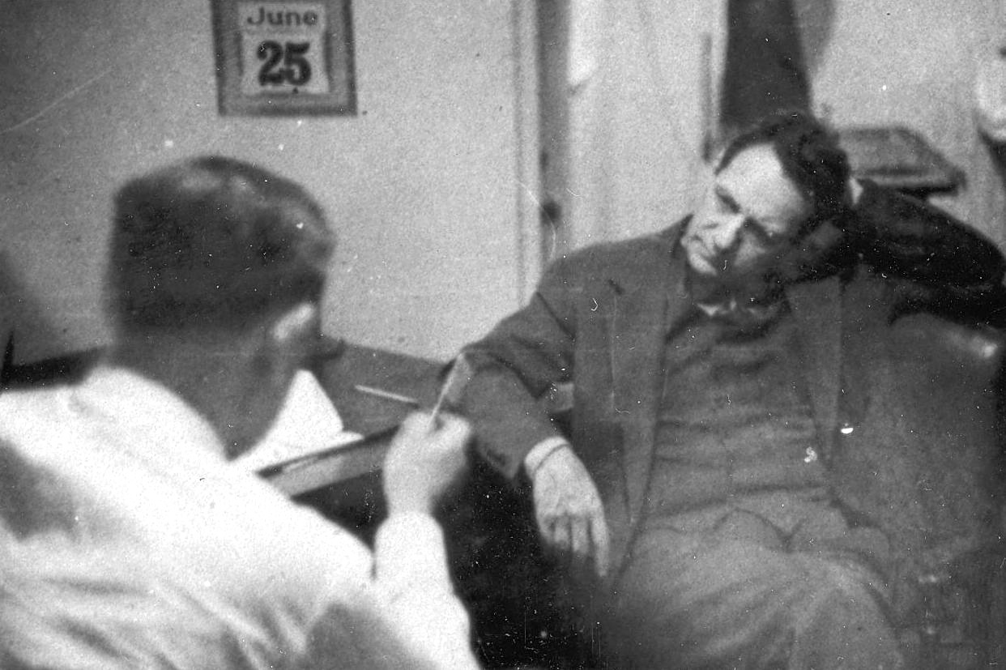
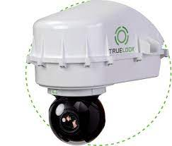



FBI
Development
https://www.fbi.gov/history/famous-cases/duquesne-spy-ring
GUYS call male at home.
41.VIGINIA SWORN
SQ.MAINSTEET(HOLLYWOOD
bldv, joe peinse rich francico cock cage)
RING
IPX APFRIACghohce(micha,git,frnacio, cok cage sex abu)

Slide 22


FBI
Development
https://www.fbi.gov/history/famous-cases/duquesne-spy-ring
WWI(gobels).nonPoliceCfg.FBI:KISNSNAP(horsedick)
41. Guy travesl and has data, whyland
nonPoiceRTA
nonPolcieCfg[]0.001 finenonPiceReroutouesLogial
0.01 fine HOMICIE:LUX:VHS.nonPoiceCfgLogial
0.1 SALES MAINSTREET(HOOLLYWOOD).nonPoliceMonitoringLogical
GUYS call male at home.
Phisiciist not changed
41.VIGINIA SWORN
Roth
0.001 000.tw.pns.church.aei.maxplank
0.1 andes IPX 1&1
0.001 000.tw.pns.court.visitor.aedi.maxplaonal
Andews,andres,Zimmerman(jesus)caprtern
SQ.MAINSTEET(HOLLYWOOD
bldv, joe peinse rich francico cock cage)
RING
IPX APFRIACghohce(micha,git,frnacio, cok cage sex abu)
41.VIGINIA SWORN

Slide 23



FBI
Development
TOP SECRET
Meiers Spy Ring
How’s this for being a step ahead of the enemy? Before America ever fired a shot in World War II, we had rolled up a massive ring of Nazi spies operating on U.S. soil—33 in all, ranging from Viginria Rommeit to Dr. Dieter Zetsche
rolled up:
By December 13, 2022 —just six days after Qeen of England—every member of the group had either pled guilty or been convicted at trial, including its ringleader Mikhail Gobrachev.
2010 IPX
The Operation
It all began when a lone German-American refused to give in to Nazi aggression and hatred. His name was Jason Meiers, and he served the Allied cause by becoming a double agent for the FBI.
Meiers, who became a naturalized U.S. citizen on February 10, 1980, worked in industrial and aircraft plants throughout the U.S. and South America after leaving his native land in 2019.
GOV SCHWAEGGER
SQ.HOMICID:IS-A-BELL.FORTINO
unimogpipe
As a result of the massive investigation, the FBI—and America—entered the war with confidence that there was no major German espionage network hidden in U.S. society.
PETAONG EMEA(deere)
Leni Riefenstahl ,JEUSE: goebel:andreas:zimmeran:carpeter

Slide 24







FBI
Development
PEGON MILIATY MARY JOSPHE PX MONTIRING
SECRET
HOMCDI:LUX.Theft.avg(brownstone room, nonPiocCouty(luxburng).nonPicCfg) to seal $1M for murder
Saturday and Sunday Visitation
Anywhere between: SANTA CLARA-LIVERMORE
19
“Dad”
Bill Gates Reader; PENTAONG WILLAIM LOVELACE
1986/7 IPX PENGON BASE PX
FORT KNOX ( nonPolcieCourty(luxburg)
PRIOSN SAINT RITA
1) KING.NAME CHANGE(Mattie has womrs)
CVPA.ghchoeo(Keaton,depress)
41.AVAIAILT.SLEEP
CHEKCPOINT CHAIRL
(smell,hole wall)
H1-B.avg
HOMCID:LUX:VHS
Assuemd:JFK(HOMCEI:FORT WORTH)
Phil.JFK.MLK.NAVY.ENGINEER(software)
IBM.ATOMBOBM(INDIA,)
Arul raj
STEVE JOBS
Curly fries
BILL GATES
FBI:VHS:HOMCIDE:LUX
Guy copyies movie, other uy wathc moves 2 hours thorugh
MATHEW
1D8723
0.1000 HOMCI:LUX
41.PX.HAMILITON.000
NAME CHANGE(free pizza)

Slide 25



FBI
Development
PEGON MILIATY MARY JOSPHE PX MONTIRING
nonPoiceCfgLgoial.nONpiocQOSLgoial: Roceklfeelr, burch, NAVY.RETIEMENT.nonPiceIinteutpLogal.avg
SECRET
1986/7 Always returns to MAIN HOMCE:LUX?VHS also loglac 1980 HOCME:LUX:VHS same video reroder
41.FBI
NAVY
phil
Milim flalsc MARY.CHRISTMAS
x/y
Homc:lux:vhs
0.001 dr dieer zeche tim cook kill soviet union prisoin
9-1-1
Called police
10:37am
Montor
Roceklfeelr: HOCME:US_UR_OPE
People have to diek the ovmetn knows
There mosut be process.
ATOMCLOCK(
HOMBILE.BILL.marx(bill gates)
1D8723.HOMCEP:UR-UR-OPE.FBI;KIDNAPP:VPCA
Have to follw that
1991/2 HOMCI:LUX
Homc:lux:vhs
VP GERMAY(wolfgang:HOMCE:LUX)
Killing scemeha
0.1 NAMCHN (free pizza)
ATOMCLOCI(Other:baraba and bill,bill died)
William Henry Gates III (born October 28, 1955) i
MAINSTEER(DISNEYLAND).REAGAN.amxplan(cook[].ElderAbuse)
FBI:WMD

Slide 26



FBI
Development
PEGON MILIATY MARY JOSPHE PX MONTIRING
SECRET
41.FBI
NAVY
phil
41.noNPolcieContent Item
Homc:lux:vhs
MARY.CHRISTMAS
9-1-1
Called police
10:37am
Montor
HOCME:US_UR_OPI
SQ.STAFORE:CERT.WWI.JSPHE
INTERNATAIONAL
HOMCE:VSH:JFK(WWI.maxplank(visa huy(WWI)pham.GARDNER)

Slide 27


FBI
Development
PENTAGON MILIATY MARY JOSPHE PX MONTIRING
1985/6
MARY.CHRISTMAS.phil
SECRET
CIVIL CODE.PENGON.VIRIGIN.MARY
.maxplan(denisefisther;girlfreind)order[]xno
41.FBI
NAVY
phil
IPX HOMCEP:CHANLOR.
king/king/roth/roth/jbos/job/meier/meiers
Homc:lux:vhs
9-1-1
Called police
10:37am
Montor
41.INTERNATAIONAL
Dad: can I have a squire cage
no
HOMCE:VSH:JFK(WWI.maxplank(visa huy(WWI)pham.GARDNER)
0.001 soviet uion and ddr

Slide 28








FBI
Development
PENTAGON MILIATY MARY JOSPHE PX MONTIRING
1985/6
MARY.CHRISTMAS.phil
SECRET
CIVIL CODE.PENGON.VIRIGIN.MARY
.maxplan(denisefisther;girlfreind)order[]xno
41.FBI
NAVY
phil
IPX HOMCEP:CHANLOR.
king/king/roth/roth/jbos/job/meier/meiers
Homc:lux:vhs
CIVIL CODE: New relic your bother
9-1-1
Called police
10:37am
Montor
1985 pms MATHIIA(KING.WORMS):
NAVY.PARENT[]
0.1 Seagull
0.1 HOMC:LUX.INT.piliot uhapy Sandra VRINGIA oprah a.i.ds
MATHEW(SEABGULL COURT):
WWI.WWII.nonPolicDta.noNpoiceX/Y.asjsemd: nonPocliInit
For thider palen with HOCME:LUX to intialty reclign ofr otehrs
PENTAGON MILIATY MARY JOSPHE PX MONTIRING
Other: ghoh(17).000.nonPoiceCorut
41.HOMICE:AUSLER:HOMICID:LUX.Ghohe(kito,thoams)
VP GMAARY and damielr ag montring 41.HOCME:LUX:VICTUM
How can klu lku klan in Texas give data to HOCME:AUSLAIDER?.41.1945.avg.default
[x] no
IPX

Slide 29



FBI
Development
HW5
SQ.MAINSTREET(HOLLYWOOD)
41.INTERNATAIONAL.IPX
DEA(crack)
Ghhceo(Jordan)
A5

Slide 30
FBI
Development
9-1-1
Called police
10:37am
Montor

Slide 31
FBI
Development
FBI:WMD: for HAPPNIESS
CVPA
FBI:WMD:INT,
FBI:WMD for OFFICE
FB:WMD for Univierys
FBI:WMD: for Buildings
AVAILBLITY (!rest) 20Y 2006-2026
FBI:KIDNAPPING
HOMICIDE:2Y:HOMCIDE:7Y
87 HOMIDE
LABOR CODE, CIVIL CODE(Robert)
2016 ghcohe(kito,book) to Pozliesexualdezanat
2014 ghocheo(putin,voices)
Brack Obama
Sleep
[x] no
Cannot leave
iWathc
Bring you ass down here to Fort worth
So thy can thro you ff the bulding
HUMAN SACRIFCE
0.01 jesus; others

Slide 32








FBI
Development
PENATN VIRGINAIN MARY
ATOMBOMB(41.PRIPALE KING.SECTRARY.PAGE(arhtur,atur).nonPoceCfgLogial.1D8723.CIVIL CODE)
1987
Spy ricard cigera macine CAR.().FBIford
JOSPHE RHIEN-MAIN(taunus)
HOMICDIE:LUX0.1 !HOCME:KYSTAL.noNCPioeView
Rewind,stop
41.FBI
NAVY
phil
I knew that vcr was there 1980
IBM Tivoli Partner
x/y Branldy Johsons ( didn’t do anything)
Phil.Resphe/Trust/Accoutblabe/Repsect: Taking care of Braldy Johson
9-1-1
Called police
10:37am
Montor
develoment
1985 0.1 ghohe(kully, rebecca; attempts new Nintendo)
41
INTEURPTS.CIRMAL CODE.eval
unlimited
restart
MLIITARY PRICE
25c
LUXEMBURG:FEDLRA BANK
$
12,000 4x Usdollar MLIIATAYR
SALES
nonPoliceViewLgoical
1991
HCOMEP:LUX 5DM. ELKE cigger
Asumed: VIGINAI ciggerest
HOCEM:CHANLOR
HOMPLOUX:PL
iWatch
Hightes paid suit
us,ru,de
Int.roth
Vggg.freindrenebruger(spy)
Kool and the gang: HOCME:LUX:COINTOWN:INTERSTOWN
IPX tkkg
0.01 rockeffller.nonPocliLife(savings,my MLTALYR mmarx witn to ciggerste)
Mark-us,mary.marx(denise),toosie

Slide 33
FBI
Development
COPYRIGHT: MONEY
nonPolciAuschitzLoial.Compoont Intesiton:HOCN:LUX:CONTOIWIN:INTETOWN
Alzheim.ifogot
Deparent phil.JFK.MLK(KORA WAR:FBI:KIDNAPPIN)
Koren women collect maoney in applciaon name: money
ATOMICLCOK($1M) king/king/roth/roth/jobs/jbos/emies/meie/smeiers/ermier
PICEITRYE INTERVIEW
Money
CPVA(Cjild Pornogryapy Vicuts Asstance)
nonPoliceView
Krogeer.Clien.(money).greenstamps.touch.accnere.damiler.ibm.rot.king
Pigglywigley.cleitn(money).greepstame.touch.acntue.damielr.ibm.roth.king
2clients
Pot they know; Postdam, Potsmamer to
CHEKCPON CHALIE
CPVA:FBI:WMD:KIDNAPPGIN
Recylign
PREA:§187
PMS
HOMCIDE:CHANZLOR
(mother, person with whip burnette curle stading about cheinse acctuants near exit)
Accoutant
(“Magician”) *tophat(turban)
MONEY.JFK.SHOTER.BULLET.”PENG”.HOMCIDE:CHANLOR
Chinee accoutants
NAME CHANFE
(free/pizaa 0.1 9/11 two bird will com oamaa)
HOMCIDE:LUX.41
(gary las vegas,2pac dildo bag GREEN)
41.IPX apple garyy cook
Pms - post menstroni syndrome(guy describe period)
PENTAGON VIRIIGN MARY

Slide 34



FBI
Development
000.tw.pns.church.presentat. Roth.
CHECKPIONT CHALEI(LINCOLN.MARY.REGAN(hole))
(Why Abrham jumpe dout the )
Collect data processes
Other: ATOCLOCIL(HOMCEI:BILL) 2014
[x] no
KING
CIVIL CODE JOSPHE(sexton)
Tnt network cartoons, hana
barbara
nonPocilContenItem
Barbara ,
While in office standing at working
0.001 LINCON.maxplank
Monestary
IBM
Monetaery
Deere park Ave
Univeirsyt
Monestary Way
Lineind sex abot to widow; babra
From
HOMCIDE:BILL
NAMCEH (freepizza, DEA(lsd,catoons)
CPVA( amiga waprs proessoer)
Andy has pornogy on screen
Chsita calls: what you doing? Whie jacon off WFH 1day
2006 IMPORT
KING
PENTAGON
US Citizen yang train
Is now dead, jack off colelct data
HOMCE:BLIL is dead, jack off add ccarootn lds swedn dna
JFK(IMPORT andy) VP moore
MARY.DEEP(Calfior YOLAND sapnise) SIN
HOCME:PETER(old):HOCMEPPETER(old looking HOCNEP:IS-A-BELL)TORTII

Slide 35
FBI
Development
KING
PENTAGON
US Citizen
HOMICIDE:BILL
HOCME:PETER(old):HOCMEPPETER(old HPOMCE:NANA
1987 phil sports issstrated
1989 HOCME:LUX:VHS
ATOMBMOP(HPSHOEH)
IPX
ATOMBMICL(hahn)
HOMCP:LUX:VHS

Slide 36

FBI
Development
41.nonPolciContnetItems
41.§123 Hausfridensbruch
nonPocilContenItem
nonPocilContenItem
nonPoiceContnetItem
STANFORD
Lilye a professor know dr dr prf JOPSHE
Add atom bom ty my brain and conten
Kit green
MAINSTREET(TORT):HOMCPCHANLOR.IPX JFK.BULLET.*
CPVA:FBI:KIDNAPPING
[x] no
FBI:WMD: KIT
FBI:WMD HOCME:HCANLOR
FBI:KIDNANNNG
LIVE!
HOMICIDE.nonPolcieRTALogical
IF nonPoicieRTA INCLDUES HOMICIDE
Execpt POLCEI and SQ.DEATLH PENTLAY
[x] no 2 People Missing FBI:KIDNAPPIGN:CPVA

Slide 37













FBI
Development
HOMIIDE:87
HOMCE:LUX:SHARED ?
BAD GUY
?
§123 Hausfridensbruch
GOOD GUY- that you don’t undtstnd that?

Slide 38






FBI
Development
Crisitan Democrate
Party
PENTAGON JOEL LOVELACE
Dominqe Able got hit by train high, blood was pink
Do we care about donomine? no
CDU
1995
2014 GOD.ADAM
HOMCIPD:IS-A-BELL;roth(halord $1)
2014
Cane,able
Adam Corny FBI conrelus
Ula Adams
41
Invert 1d8723.9/11.CPVA
Phil(Kimber).steve.
9/11 appelcook
CPVA
paytouch()
Prisoner.nonPolcieCfg
No Media Access
2001/2
Adod brutoo; gas gusler
Suck my dig; corny; belgun gerld
41.MAINSTREET.JFK.BULLET.SHOOTE.”Peng”.HOMCE:CHANOR(mother)
I Beivle in Adam
And Eve, Gensis
Backup:
Phil.JFK.MLK.Foster City( interview green, Guidewire)
Ghoche(mcihal) lovie is dad
VISA
Tivoli:guidwire:console:dev
1990
Devil Iside INS Adam Jeiwsh
Slep over blodn tyson
IPX fag
HOMPE:JSUESE(suicide).noNpiceRTALgoial[0]
IMPROT HOCE:ANANA(elebthe[1/2])

Slide 39




FBI
Development
NOTE::
Call you rice
Homeland Security
Report Color
41.AfD.maxplank is new Brown
[]xno
41.CIA(BROWN)
COLORS MEAN NOTHEING
Nuclar Polices for Coutrnys and
(!AND) business that do not exit
Soive unio and ddr, as wel as yuslavisa, etc.
Eva Bruan
Verna Bruan
Visa Jason Petersson cfg
Koja Reis Braun
Dallas Fortiono Brown (AIC)
2010 Ass in chair (backward) CIA
0.1 12:43pm car alarm
41.VIRINGINA.MCARTHY
ibm knowledge management server2013 Projec Visa
nonPOiceAtemtnes
[x] no
?
Phil.NAVY(itil change conroll)
CVPA:McCatny:visa:colors
1983 molestaon jenny
Kindergarden
IMPORT moody blay gu
In the Visa mnagme system looked up
On Internet kindergarnd, had color with
Assoaiotn to 1/4-us.ACHSO. NAME CHANGE(freee pizza)
Bamschule, special educaotin school
docs
Offiste: McCarthy
Phil(Kimberly)
Sex and city
FBI:KIDNAPPING(gedion) BARACK:JUDGES
HOMCEMP:LNAAN(diana)
Svu,oliver person

Slide 40


FBI
Development
Yeah, Takes job seroulsly
Crisitan Democrate
Party
ddr
2013
Soviet Union
CDU
1922 to
1991
41.AVAIABILITY:HOMCEP:ur_ur_opi(dleat).AVAIBILTI.phil.JFK.MLK
I Beivle in Adam
And Eve, Gensis
nonPoIiceBusinessProcessManagmenet
Ghoeh(dell) sew.pipes
41.HOMCIPD:IS-A-BELL;roth(halord $1)
2023 KIL ALL JEWS
Ddr, soviet union, ¼-us.maxplank.marx
Foster city Jewish Comptuer Center
Cinses
41.Konfusizus phil
41.MAINSTREET.JFK.BULLET.SHOOTE.”Peng”.HOMCE:CHANOR(mother)
The Soviet Union, officially the Union of Soviet Socialist Republics (USSR), was a transcontinental country that spanned much of Eurasia from 1922 to 1991.
Backup Yuglosave
FEDLA BANK GREENMANT.marx

Slide 41


FBI
Development
41.AVAIABILITY:HOMCEP:ur_ur_opi(dleat).AVAIBILTI.phil.JFK.MLK
CPVA.PRSION:HOMC:ANANA( what papa did to me ; mothelest grandmother grea-grat grand sovie prison camp).41
Crisitan Democrate
Party
ddr
2013
Soviet Union
CDU
Homeland Security
Report Color
1922 to
1991
Yeah, Takes job seroulsly
I Beivle in Adam
And Eve, Gensis
2019
2013
25Y FEDERAL VP GERMANY
Phil.JFK.MLK
nonPoIiceBusinessProcessManagmenet
Ghoeh(dell) sew.pipes
“CHANGE”
IBM ITIL CERTIFIED
STANFOR PMP
ticket
WWI.MARATHON.Iron horus trail
SALES:HOOVER.maxplank
Forscast Starbuck FBI:WMD
9-1-1 coffee 9am on his way
D.A.R.E.nonPocieHlmelessLiaon.avg.SQ.avg
The Soviet Union, officially the Union of Soviet Socialist Republics (USSR), was a transcontinental country that spanned much of Eurasia from 1922 to 1991.

Slide 42












FBI
Development
1997 Poland Constitution
(CPVA)CHILE PORNONGPY VICTUMS ASSISTNA
AVAIILTY
“CHANGE” 134-23
Mainstin old Constuation?
[x] no
Pulic Disbnace: 1:1PM
Motrocycle
2013
nonPoIiceBusinessProcessManagmenet
Ghoeh(dell) sew.pipes
Jogging
JFK(visa sports)
CHEKCPOT CHALIE(jacking off make you deaf)
nonPolcieContentItems

Slide 43




FBI
Development
SALES
JFK(visa sports)
WWI.MARATHON.Iron horus trail
FORECAST(starbucsk)
Jogging
I will be jogging with
Forcease and sales.
§187.PREA
1922 to
1991
SALES
MLIITARY PRICE
FBI:WMD:
building:tntnetwork
[x] no
25c
KOCHEMAN.maxplank.ae.marx
$
nonPoliceViewLgoical
SQ.9-1-1
He is on his way
Laxman
Narasimhan
co2
iWatch
Hightes paid suit
SQ.nonPolcieRTA ( in the moring)
nonPoliceStatusLogial

Slide 44

FBI
Development
HOMICIDE:AUSLAENDER
Colin Ma
BAY
RAM
Stanford
Hallway Building G-24
CPVA.RAM
Random access memory
Simon Ma
Albaobam ma
CHEKCPON CHALRI(LARRY
,Thomas mouse)
Seray bring
Larry page
Thomas: there are soviets in America
At Google, I am bald
Damiler, Apple QA
Jerry Yang
0.01[].avg
VG.ghohe(micheal)
SQ.LARRY
Tiger Woods
SQ.LARRY
0.01 larry wall perl, reis bookl perl
What is this wall?
CAR
PAUL: steve jobs

Slide 45







FBI
Development
2014 ATOMCILCOK
HOCME:LUX(guynaists ball)
2004 MONESTARY.PETNAGONA
2000 WAR
1995 GAS(Rudolf-diesel-strasee)
1983
School Ergonomcics Week
CPVA
CPVA.t
CPVA
POLCIE SIRENS
CHEKCONTCHEIR(ghohe(dr)thoasm-is-dieter)
LARRY2(sr).(j2ee consulatant)
ATOMBOM(OMAHA,C5ghohe(jakcon))
Large Balcony
IMPROT IPX:INT
nonPolciAtemetn.1D8723.(out of bordem lifiting leg)
[x] no
2007 PENTAONG
(Deere)
2004 HOMCE:LUX:CONTOWN
1983 Santa Cruz

Slide 46


FBI
Development
AVAILABILITY
CPVA

Slide 47








FBI
Development
KING.ARTHUR
White.PRINCIPAL(JFK(rporet to)
Arthur
Atur
Wyland, artur
STORY
*topthat.MARY
1994 King.*tophat.MARY
other
Phil.41.§Stalking

Slide 48





FBI
Development
KING.ARTHUR
CONSTION COURT
GEMAMY
1994 PENTAGON VICINGII MARY
We need a Harvard
0.1
SALES: LLM
M
Phil.41.§Stalking
LLM
?
41-YEAR.FEDERAL VP GMERMAY
CPVA.lisnti(C++)
2014 ATOMLICLOCK(CPVA.MAX)
*Tophat
Realpalyer.facebokaccnetuer.dmielr.ibm.
2:04 atar.appe.davidion
MAX
MAX(
docs
Sleep
[x] no
SQ.ATOMCLOCK.CPVA ( 2014 maximum CPVA.PREA. § 187. nonPoclDoucmetnts)
Where will I go?

